Slide 1

Integrating HeCiX and GPT-4
- Prerana

Slide 2

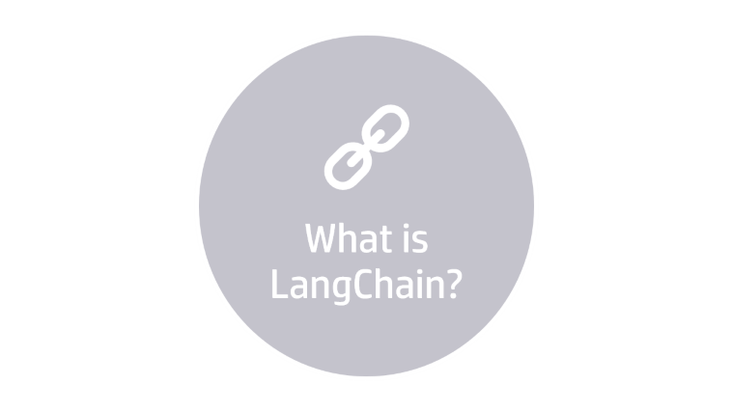
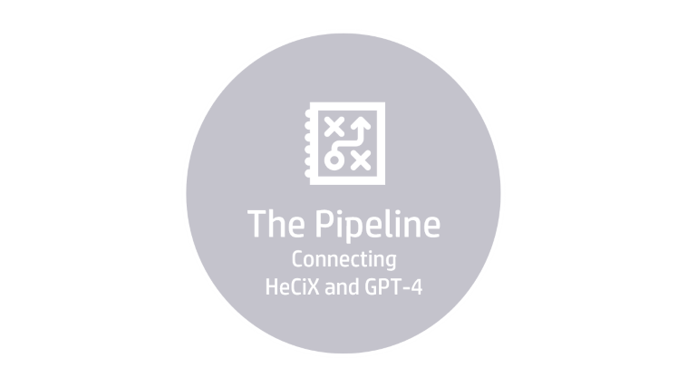
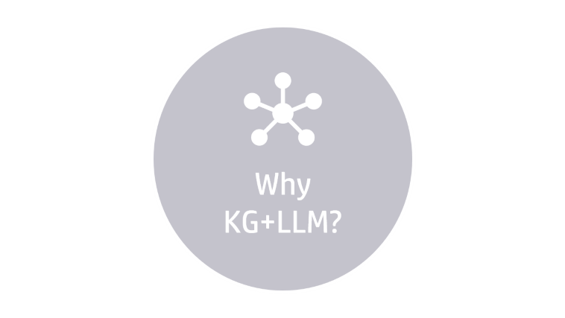

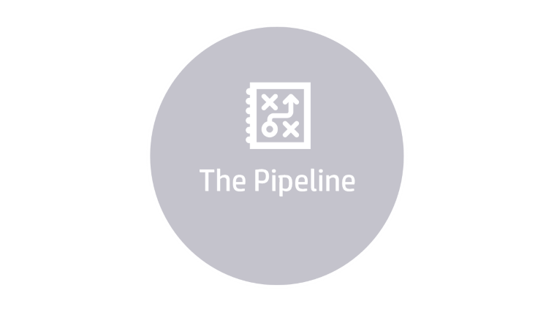


Slide 3

Why KG+LLM?

Slide 4

Why KG+LLM?
Take a step back. Why do we need to connect a KG with an LLM?
 | Large Language Model | Knowledge Graph
Good at: | Understanding and generating human-like text. | Efficiently organizing and linking vast amounts of structured data.
Not good at: | Accurately extracting and manipulating structured data. | Natural language processing and understanding context outside of predefined structures

Slide 5

What is LangChain?

Slide 6

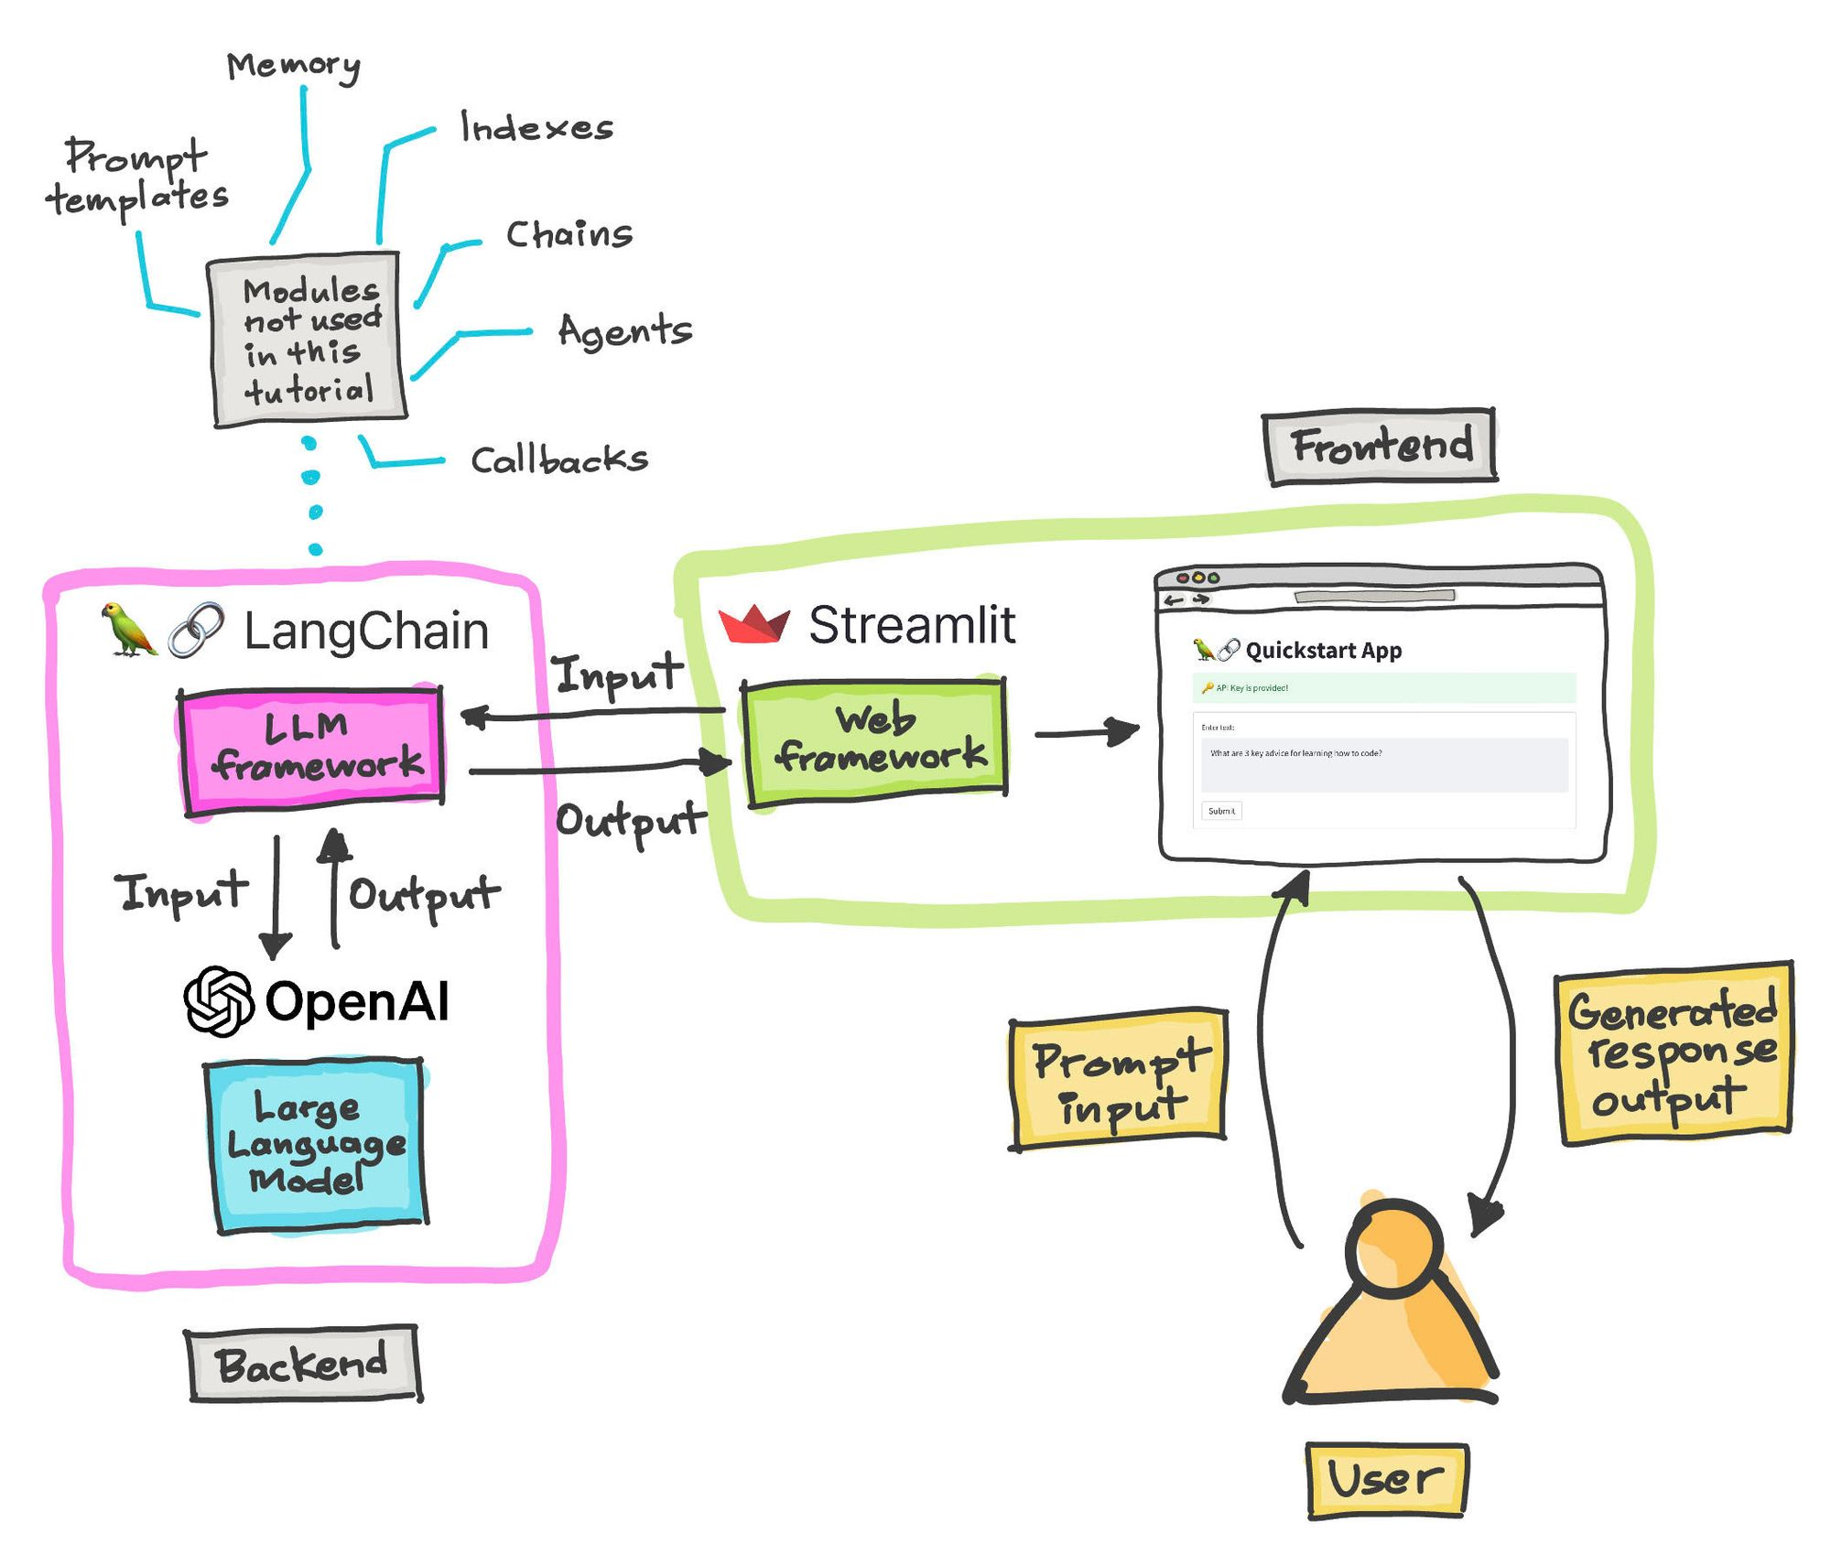
What is LangChain?
LangChain aims to bridge the gap between large language models (LLMs) and other data, allowing for more intuitive and efficient information retrieval.
It provides tools and infrastructure to easily integrate LLMs into various projects, enhancing natural language processing capabilities.
Accessing additional information WITHOUT FINETUNING.

Slide 7

The Pipeline

Slide 8

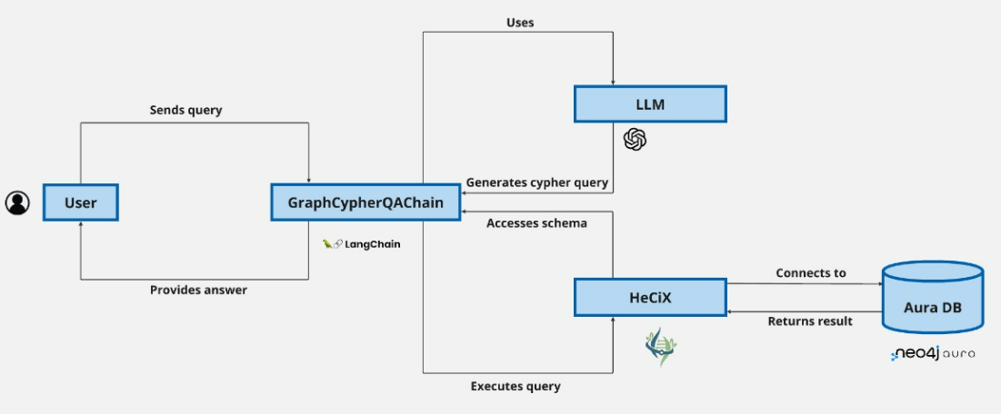
The Pipeline
Connecting HeCiX and GPT-4

Slide 9

Results

Slide 10

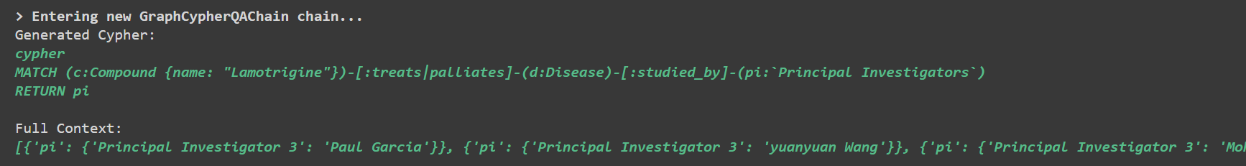
Results
https://colab.research.google.com/drive/1WpVPtUjS_bfetmNIJfIsOe4SWI1Xkzt7

Slide 11
References
https://www.langchain.com/
https://www.youtube.com/watch?v=Wg445gThtcE&ab_channel=Hands-onAI
https://www.clinicaltrials.gov/

